Slide 1
Black Hat Python!
12.1. 2019 Antti Virtanen
@Anakondantti – antti.virtanen@solita.fi

Slide 2
Legal
The information is for educational purposes.
Do not attempt to break into systems or exploit them without a permission!
Legal hacking:
Hackthebox.eu
Shellterlabs.com
Vulnhub

Slide 3
Why? (Fun & Profit ?)
Sometimes the existing tools are not sufficient.
Because it’s fun.
You become a better hacker.

Slide 4
Disobey CTF Spoiler alert.

Slide 5
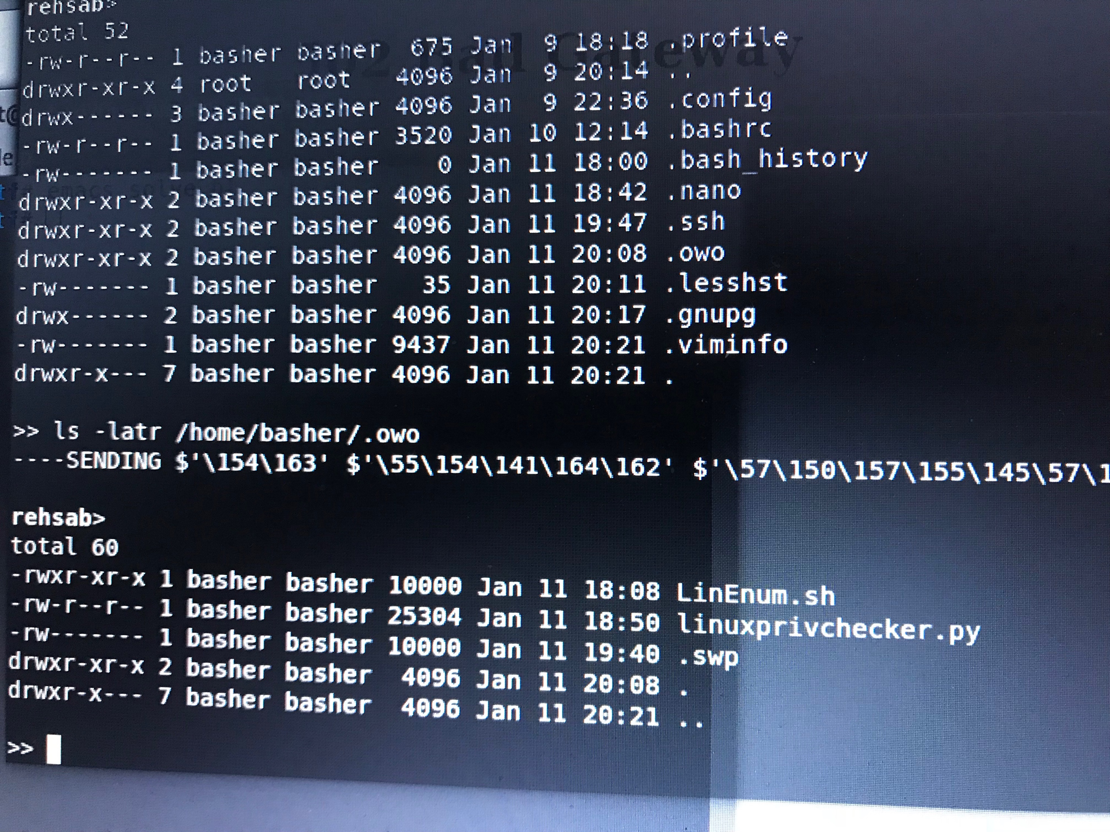
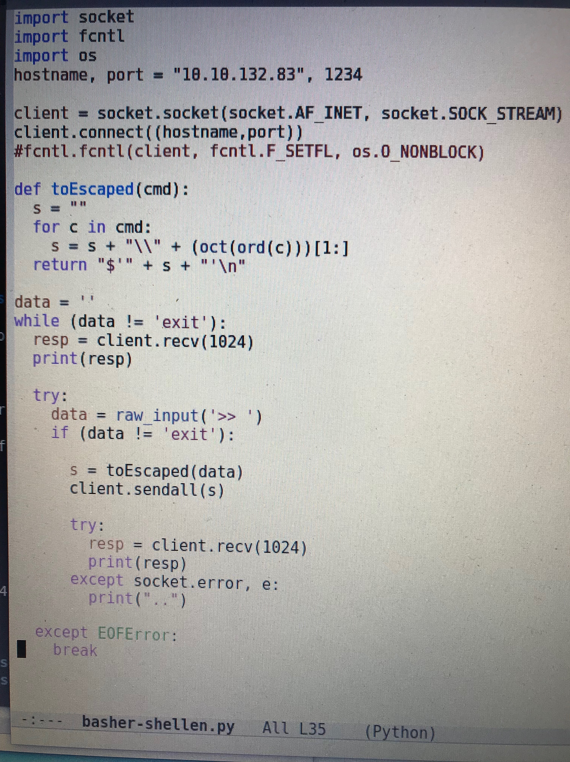
Forget “Professional” software development.
Notes:
The code on the left might have something to do with the Disobey CTF.
(Notice that the mighty owodelta has been there)
(Btw. The script on the left is not the final version, but close)

Slide 6
Okay, time to hack.

Slide 7
https://github.com/solita/blackhat-python/
Get stuff from GitHub.
Choose a task.
Start hacking some Python!

Slide 8
Notes:
https://twitter.com/SolitaOy
https://www.facebook.com/Solita
https://www.linkedin.com/company/solita-oy/
https://www.youtube.com/user/SolitaOy

